Slide 1
Jaime Deming
Jaime1.deming@cms.k12.nc.us

Slide 2
What is it anyway?
https://www.youtube.com/watch?v=NMFQUtHsWhc

Slide 4
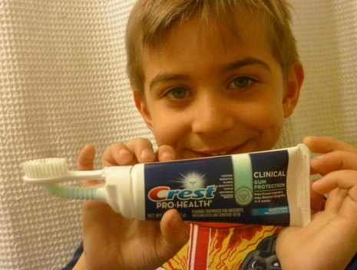
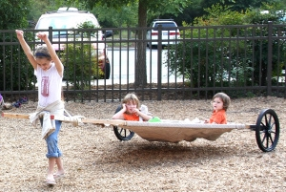
80/20
Google’s 80/20:
Spend 80% of your time working on assigned work
Spend 20% of your time learning or researching thing that interest you that will benefit the company in some way
During this 20% time Google employees have created things like Google News and GMail!
Education’s 80/20:
Spend 80% of your time working on assigned work by your teacher
Spend 20% learning about things that your passionate about, curious about, or interested in.

Slide 5
1. Generate
2. Focus
5 Step:
Genius Hour Design Process
3. Ideate
4. Act
5. Share

Slide 6
1. Generate
Start with a question
What do you wonder about?
What is a good question about something I am interested in?
What is my passion?
Can I put my question in Google and get the answer immediately?
3-4 Star Student Example Questions
What does my family tree look like?
How has fashion changed over the years?
How can homelessness be ended?
How are animals in Ireland different than animals from other countries?
Where is the best place to travel on a family holiday?
How do you make coulouring books?
How do you use sign language?
How has technology changed over the last 200 years?
1-2 Star Student Example Questions
How far away is India from Dublin?
What football player gets paid the most?
What are the capitals of all EU countries?
When was the first mobile phone invented?
How old do you have to be in order to be president?
Why does the US flag have 50 stars?

Slide 7
Research Question Quality Rubric
1 Star
2 Stars
Can easily Google to get the answer
Does not require research
Answer is only one word or a couple words
Key words: Who, when, where, sometimes what
Can Google to get the answer
You get the answer by going to one source/website
Answer is only a couple sentences
Key words: Who, when, where?
3 Stars
4 Stars
Requires some research to answer question
Answer requires some detail
Cannot easily Google to get the answer
Key words: how, why, sometimes what
Requires a lot of research to answer question
Answer requires a lot of detail
Cannot Google the answer
Key words: how, why, sometimes what

Slide 8
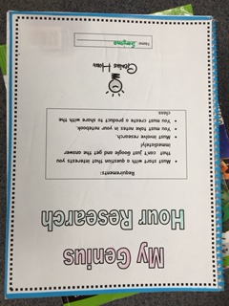
2. Focus
Research
How do I make sense of my challenge?
Do I need to conduct an experiment?
Do I need to do any interviews?
Should I survey anyone?
Graphic Organizers
Taking notes
Citing Sources

Slide 9
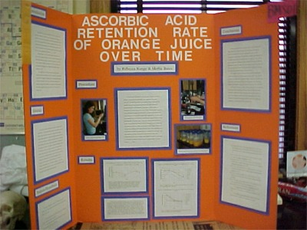
3. Ideate
Brainstorm a product to share your new learning with others
What do I create and how do I share it? (ie. Movie, poster board, power point, website)
Brainstorm
Action plan
Blue print
Rough draft

Slide 11
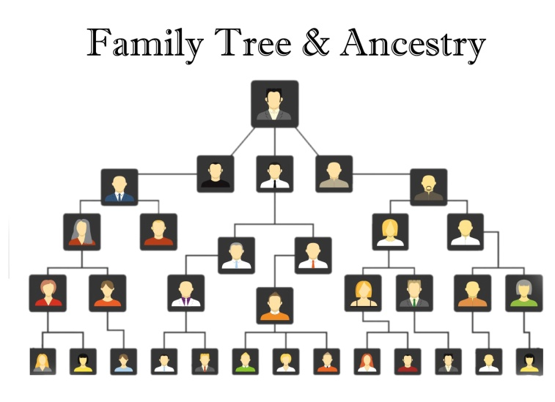
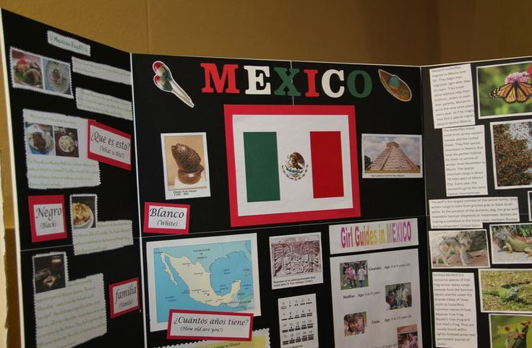
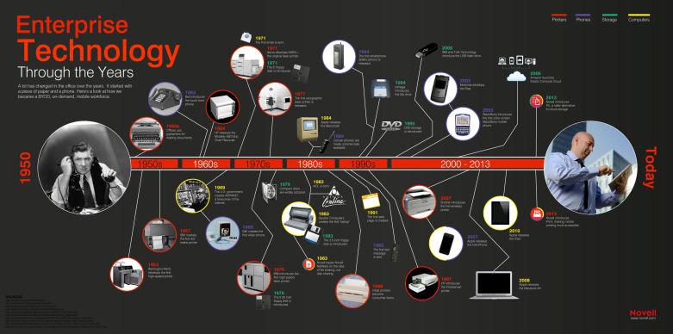
4. Act
Create your final product.
A student who wanted to know how to use sign language created a video teaching other how to use it
A student that wanted to learn more about Mexico created a tri-fold poster board teaching others about Mexico
A student that wanted to know his family history created a family tree using ancestry.com
A student that wanted to know the best place to take a family vacation created a brochure of the place they thought was best
A student who wondered how technology has changed over time created a timeline and brought some examples into class to demonstrate how they work during his presentation.
One student created a Weebly website teaching others the negative affects of child abuse and trying to put an end to it

Slide 12
Product Ideas
Website
Podcast
Mural
Brochure
Infographic
App for phones
Play
Songs
Physical Model
Blueprints
Edible model
Awareness Program for an organization

Slide 13
5. Share
Students must share their new learning with the class.
Things you could do to share their projects…
Invite other classes in
Invite their parents
Make it a celebration with just
your class!

Slide 14
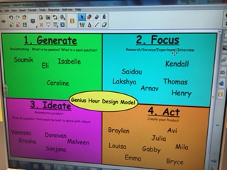
Keeping Track of Students’ Progress
This is displayed on my Smart Board during every Genius Hour. Students know each stage of the design model process. They move their name to whatever stage they are at. This makes it easy for me to keep track of their progress.

Slide 15
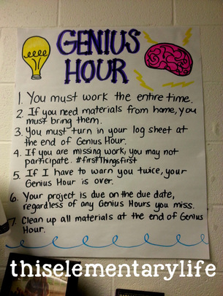
Genius Hour Rules
3 Basic Rules:
Must begin with a question that requires research
You must not be able to Google your question and get an answer right away
You must share your findings with others
You must work the entire time
You must turn in your Genius Hour Log at the end of each Genius Hour.
If you need materials from home, you must bring them
You must take notes as you are researching
If I have to warn you twice, your Genius Hour is over
Your project is due on the due date, regardless how many Genius Hours you miss
Clean up all materials at the end of Genius Hour
Your project must contain a bibliography

Slide 16
Genius Hour Rules
You will spend 20% of our class time over the second semester working on what we will call, “Genius Hour”.
You must work ALONE. This is about conjuring YOUR inner genius, creativity, passions, and intelligence.
Choose a project that is new to you and something you would not normally do in another academic class.
You must produce a product, invention or achieve some sort of goal.
If, at any moment, you feel lost, overwhelmed, or uninspired, you must set a meeting with me to find a solution.
FAILURE IS AN OPTION. Simply learning from your mistakes teaches you so much!

Slide 17
What is your goal for next time?

Slide 18
Ocean
Writing
Running
Traveling
Dogs
Organic Foods
Monkeys
Cooking
MUSIC
What are your Passions?
History
Lacrosse
Ancestry
Twins
Fossils
Family
Technology
Reading

Slide 19
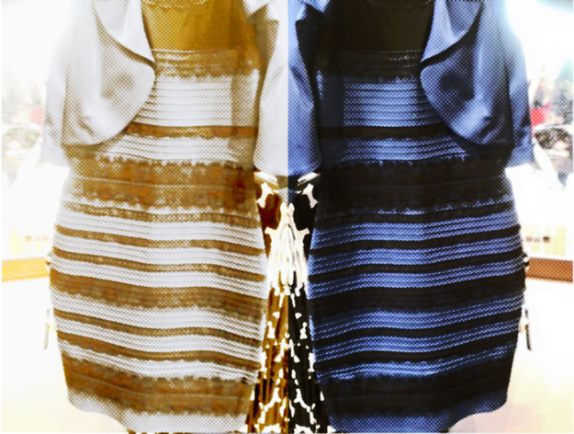
Is organic food really better for you than non organic?
What is the most beautiful beach in the world?
Why do people’s hair turn grey as they get older?
How does cancer spread?
How does a plane fly?
What does “all natural” really mean on food labels?
What do you wonder?
What can you do when you’re younger to live a longer life
How I can bring awareness to stop smoking?
How did dinosaurs become extinct?
The Facebook Debate:
Why do some people see gold and white and others see black and white?
How can I bring awareness to take care of our environment?
Why do people shrink as they get older?

Slide 20
Introducing Genius Hour Step 3 – Teach your kids how to do research and stay organized
The Research T-Chart
Notes (Research)
Left Side
Sources (Websites)
Right Side

Slide 21
Resources
www.geniushour.com
https://bitly.com/bundles/eduthompson/9
Peter Reynolds Books
Kid for President Videos

Slide 22
Questions?

